Slide 1
Long Island Population Health Improvement Project (LIPHIP)
June 16, 2016
This meeting is now being recorded.

Slide 2
PHIP Grant Updates
PHIP 3rd Year Budget Planning
Asthma Coalition of LI Quarterly Meeting Recap
Healthy Homes Pilot-CDCI
Get Your Tail on the Trail, St. Luke’s University Health Network (PA)

Slide 3
DSRIP Performing Provider System Partnerships
PPS Updates
NQP PAC meeting 6/15/16: Increase Community Awareness of Alternatives to ED Use
CBO Summit Advisory Meeting 6/16/16 Recap

Slide 4
Growth of LIHC Membership
Membership
NYS DOH Healthy Resources
Networking Event Blast VS. LIHC Calendar
Networking Event Blast: To promote member fundraising or networking events
LIHC Calendar: Those events focused on learning about health resources or participating in healthy activities

Slide 5
LIHC Website, Portal and Social Media
Social Media Engagement Report
Toolkit for Promotion of Website
Outreach Assessment Activity

Slide 6
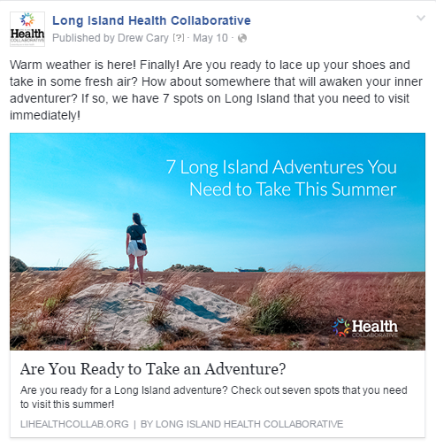
Facebook
Total Posts: 18
Total likes: 271
Net likes: 106
Organic: 53
Boosted likes: 66
Total Reach: 66,000
Organic: 12,467
Boosted: 53,532
Total Engagement: 2,900
FOR REFERENCE: April Facebook Stats
Total likes: 152
Net likes: 42
Organic: 41
Boosted likes: 3
Total Reach: 15,216
Total Engagement: 541

Slide 7
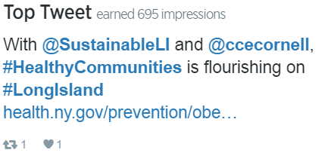
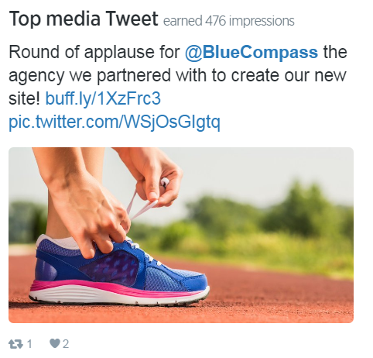
Twitter
Total Tweets: 38
Total followers: 171
Net followers: 20
Impressions: 8,913
Profile visits: 447
Mentions by others: 20
FOR REFERENCE: April Twitter Stats
Total followers: 151
Net followers: 17
Impressions: 3,567
Profile visits: 389
Mentions by others: 26

Slide 8
Definitions
Net Likes/Followers – Net likes are the number of new likes minus the number of unlikes, giving us our total outcome.
Organic vs Boosted likes – Boosted likes are categorized as likes that occur within 1 day of viewing an advertisement, or 1 month (28 days) after clicking an advertisement. All other likes are considered organic.
Facebook Reach – Total reach is defined as the number of people who were served any activity from our Facebook Page including posts, posts to our Page by other people, Page like ads, and mentions.
Engagement – When a person interacts with a social post, by liking it, clicking on a link, expanding the text, clicking through the profile page, etc., these are considered engagements.
Twitter Impressions – An impression happens each time a users see our tweet in their Twitter feed.

Slide 9
Public Education Outreach & Community Engagement
Promotion and Trademark of Are You Ready, Feet? ™
Sunset Stroll at Jones Beach, July 21, 2016

Slide 10
LIHC Hashtags
#readyfeet
#healthcollab

Slide 11
Academic Partners Survey
Student Opportunities Listing
LIHC Engagement Activation Partnership (LEAP) Tuesday, July 21, 2016

Slide 12
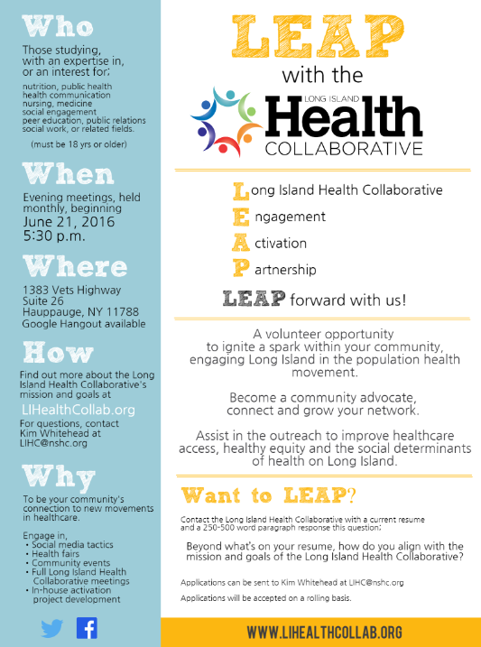
Committee Description: This committee is comprised of students and community advocates who hold a vested interest in improving access, health equity and social determinants of health care within communities on Long Island. The purpose of this committee is to light a spark in community members around population health and healthy living. Volunteers must be 18 years of age or older.
Target Audience: Cross-representation from academic institutions and multi-disciplinary fields of expertise on Long Island.
Audience may include, but not limited to, those with an expertise or interest in: nutrition, health communication, public health, nursing, medicine, social engagement, peer education, general communications or public relations.
Member Expectations: Attendance at evening monthly meetings; regular review of participation in activities

Slide 13
LIHC Activation Engagement Partnership
To apply: Send current resume and 250-500 word paragraph response to question below to LIHC@nshc.org “Beyond what’s on your resume, what makes you want to be involved in the mission and goals of the LIHC” Applications will be accepted on a rolling basis. Long Island Health Collaborative: For more information visit: www.lihealthcollab.org Or email LIHC@nshc.org

Slide 14
10 Minute Stretch Break & Sign up for Workgroup Participation

Slide 15
Complete Streets/Nutrition and Wellness
Creating Healthy Schools and Communities Grant NYS DOH
Eat Smart, New York (ESNY), USDA
PHIP Leveraging Existing Partnerships: Google Poll Response
Healthiest Cities and Counties Challenge Prize

Slide 16
Grant | Creating Healthy Schools and Communities NYS DOH | SNAP-Ed Eat Smart New York (ESNY) USDA
Overview | Grant Partners: Western Suffolk BOCES, Sustainable Long Island, Stony Brook University Five-year (2015-2020) public health initiative to reduce major risk factors of obesity, diabetes, and other chronic diseases in high-need school districts and associated communities statewide. Goal: to implement mutli-component evidence-based policies, place-based strategies, and promising practices to increase demand for and access to healthy, affordable foods and opportunities for daily physical activity. | Grant Partners: Cornell Cooperative Extension (Nassau and Suffolk), Family Residences and Essential Enterprises (FREE) Five-year (2014-2019)community-based nutrition education and obesity prevention program to reduce major risk factors of obesity, diabetes, and other chronic diseases in high-need school districts and associated communities statewide. SNAP-Ed ESNY utilizes a variety of hands-on education strategies in the community and partnering agencies. Goal; to implement comprehensive multi layered evidence based strategies : improve the likelihood that persons eligible for SNAP will make healthy food choices within a limited budget and choose physically active lifestyles consistent with the current Dietary Guidelines for Americans and the associated USDA Food Guidance System, MyPlate.
Target | Targeted communities: Brentwood, Central Islip, Southampton/Shinnecock Indian Nation, Wyandanch and Roosevelt | Suffolk and Targeted communities: in Nassau Roosevelt Uniondale, Glen Cove, Hempstead, Freeport,

Slide 17
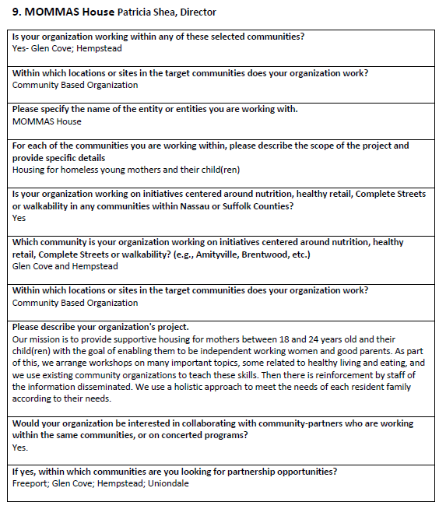
Partnership Google Poll

Slide 18
Healthiest Cities and Counties Prize
How does the project address population health and health equity in target communities?
What cross-sector collaborations will be used to establish or build upon between health and other sectors?
What measures will the cross-sector team use to evaluate the changes?
Is the project replicable and sustainable?
What evidence based practices are part of the project, program or policy being proposed which will lead to positive changes in health and health equity in the community by the end the challenge?
How will information be shared about the project, program or policy to the community and beyond?

Slide 19
Cultural Competency/Health Literacy Workgroup
RFP for Vendors-Responses being reviewed
Annette Johnson-NYS Office of Minority Health

Slide 20
Data Workgroup
Sub-County Health Data Report for County Rankings-Related Measures 2016
Community Member Survey-Second Analysis
PHIP-Specific Community Health Assessment Template for Hospitals and Counties
Status of County Data Reports and Vital Statistics

Slide 21
Data Workgroup Continued..
Wellness Portal and Complementary Training Session for Wellness Survey Use
Suffolk Care Collaborative Partnership
Cancer Data

Slide 22
Questions/Feedback?

Slide 23
Upcoming Meetings
August 11, 2016: 9:30-11:30am
September 14, 2016: 2:30-4:30pm
October 13, 2016: 9:30-11:30am

